Slide 1

By: Loh Jianxiong Christopher, Li Mengran

Slide 2
Introduction to Eclipse
A powerful IDE (Integrated Development Environment)
Provides many features and tools to aid in software development
Download the latest Eclipse from: http://www.eclipse.org/downloads/
“Eclipse IDE for Java Developers” should be sufficient for this module
This tutorial has three parts:
Part A: Setting up a project
Part B: Debugging
Part C: GUI development

Slide 3


Slide 4
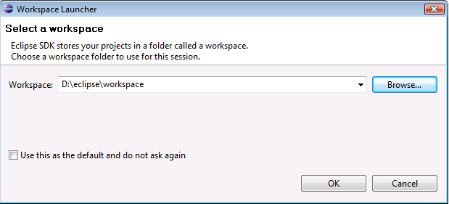
Starting Eclipse
When you first start Eclipse, you will be asked to set a workspace folder, which is the location where all your project related files will be stored

Slide 5
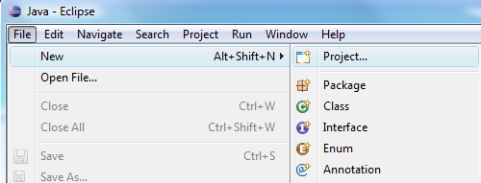
Creating HelloWorld Project
On the top menu bar, click:
File → New → Project.

Slide 6
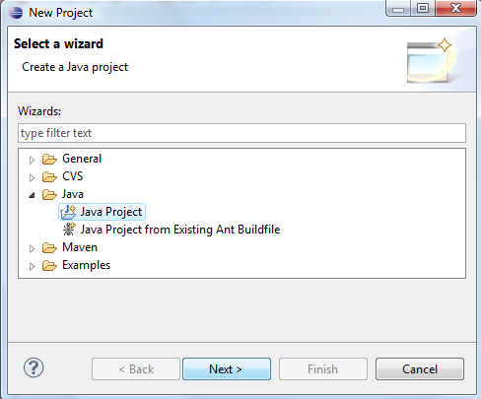
Hello World!
Select “Java Project” from the wizard, and click “Next>”

Slide 7
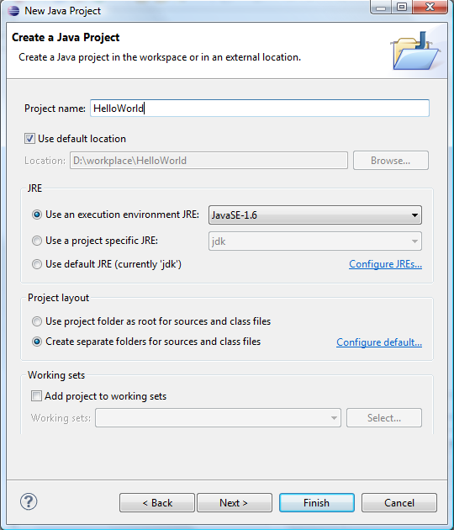
HelloWorld
Type in our project name “HelloWorld” and click “Finish”.

Slide 8
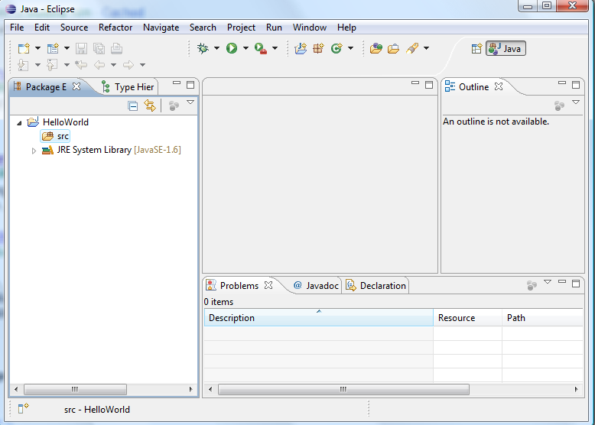
The Workbench
That should bring you to something like this, called the ‘Workbench’. It has following main components.
The package explorer pane displays the various files (some source, some bytecode) included in your project in the form of a tree.
Click the triangular buttons to the left of the individual folders to expand or collapse them. (If a folder is empty, the expand/collapse button is not displayed)
This is the editor area. Since no file is opened, it’s blank.
This is where various output from the IDE are displayed. We are currently at the Problems pane.
The Outline pane displays an outline of a structured file that is currently open in the editor area, and lists structural elements.

Slide 9
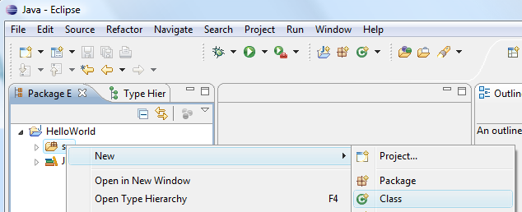
Adding a new class
Now, let us add a new class to our project.
Right click on the folder “src” and select New -> Class

Slide 10
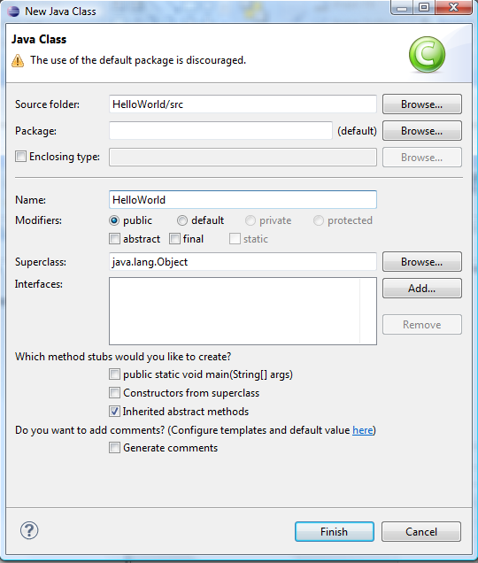
Name the new class
In the Name field, type in “HelloWorld” Then press “Finish”.

Slide 11
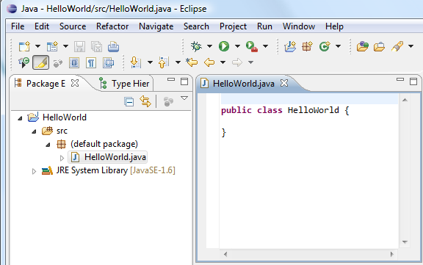
Start Editing
To star editing, double click “HelloWorld.java” in Package Explorer to open it up in the editor pane.

Slide 12
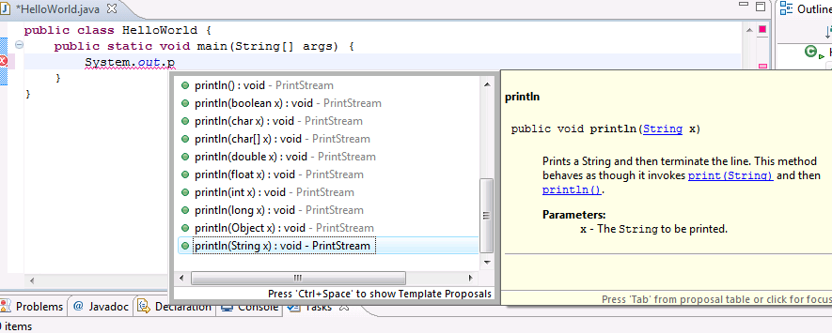
Eclipse Code-Assist
Now write the main function as shown and type in:
System.out.println(“Hello World!”);
When typing code, the code-assist window pops up to help the user. This is called the ‘code assist’ feature. Doubleclicking a selection will have Eclipse fill in the rest of the code

Slide 13
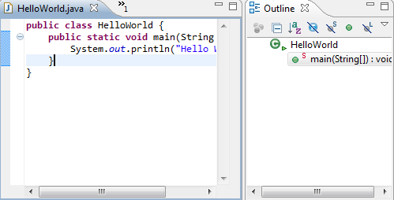
Outline Pane
Notice that the Outline pane gives a structural view of “HelloWorld.java”, that it contains the class “HelloWorld”, in which there is a function “main”.

Slide 14
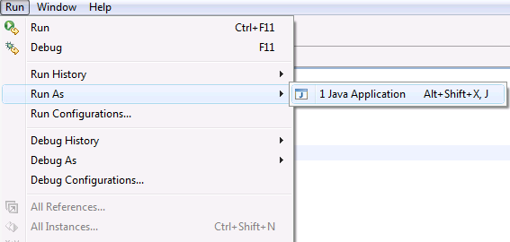
Running HelloWorld
To run our project, select
Run -> Run As -> Java Application
Note: In Eclipse, there is no need to compile before running
(compilation is done automatically as you type).

Slide 15
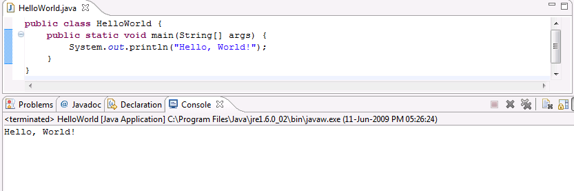
Output
Program output is displayed below the editor window under the ‘Console’ tab

Slide 16


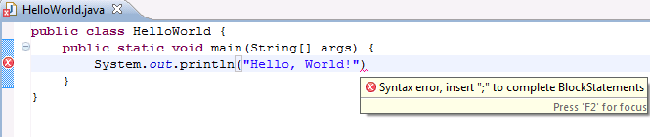
Error Detection and Correction
in the left margin means there is an error on that line.
Red squiggly lines ( ) indicates where the error is. Moving the mouse over either will bring up a description of the error
For example, had we forgotten to type the “;”, we’d see this error below.

Slide 17
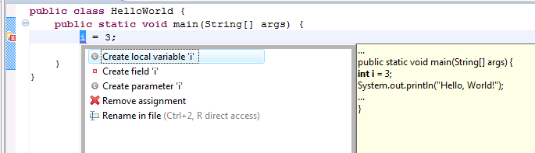
Error Detection and Correction
Sometimes Eclipse can attempt to correct errors. This is available when a light bulb icon is displayed on the left margin.
We just have to pick a suggestion listed and Eclipse will do the correction accordingly.

Slide 18
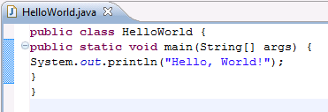
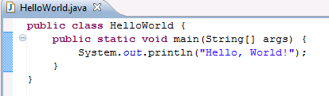
Auto Formatting
Select Source → Format, or press Ctrl+Shift+F will auto format your code according to Java conventions

Slide 19


Slide 20
Eclipse Debugger
Eclipse contains a powerful debugger than enables us to easily find and fix problems
It lets us suspend a program during execution, in order to allow the user to step through the code line by line
We will demonstrate the basic functionality of the debugger first and then debug a buggy program.

Slide 21
Eclipse Debugger
To demonstrate the functions of the Debugger, we will be using this piece of code:
    public class Search {
    public static void main(String[] args) {
    int[] array = { 1, 2, 3, 4, 5, 6, 7, 8, 9, 10 };
    boolean result = searchArray(array, array.length, 15);
    System.out.println(result);
    }
    public static boolean searchArray(int[] a, int length, int x) {
    boolean isFound = false;
    for (int index = 0; index < length; index++) {
    if (a[index] == x) {
    isFound = true;
    }
    }
    return isFound;
    }
    }

Slide 22
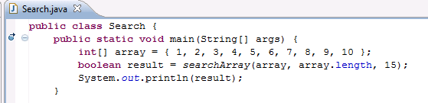
Breakpoints
Before we can begin debugging, we need to set a breakpoint
Whenever the debugger encounters a breakpoint, the program will be suspended to allow the user to start debugging
To set a breakpoint, double click on the left margin in the editor window. To remove a breakpoint, double click on it again.
If no breakpoint is set, the debugger will automatically suspend only if it encounters an exception during runtime
Here a breakpoint has been set next to the main method. When we start the debugger, the program will suspend when it reaches this point in the code

Slide 23
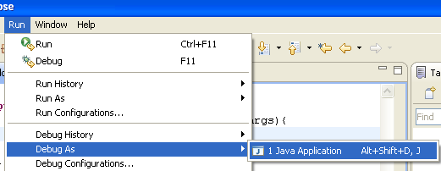
Running The Debugger
To run the Debugger, select
Run -> Debug As -> Java Application
This brings Eclipse to the Debug Perspective

Slide 24
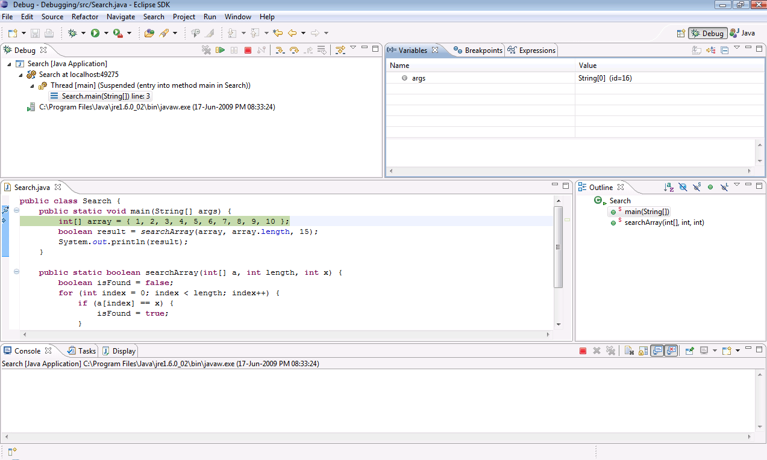
Perspectives
Notice how this changed from ‘Java’ to ‘Debug’
Now the IDE is in debug ‘perspective’.
A perspective is a set of views and windows. It provides the user with the necessary views and windows for a certain task.
The default perspective that we have seen so far is the ‘Java’ perspective, and is used for coding.
When Eclipse debugger is run, the workbench automatically switches to the ‘Debug’ perspective.

Slide 25
Debug Perspective
These are the main components of the debug perspective.
Variables associated with current stack
Program stack frame
Editor window. The next line to be executed is highlighted

Slide 26
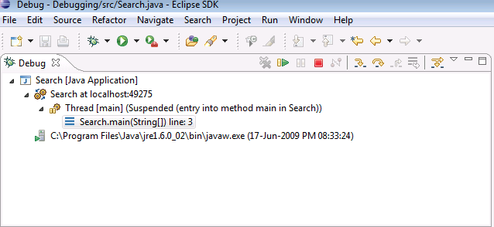
Stepping Through Code
These 3 buttons, “Step Into”, “Step Over” and “Step Return”, allows the user to Navigate through the code
Step Over: Executes current line and suspend at the next line
Step Into: Moves into the method or constructor at the current line
Step Return: Executes until the current function returns and pauses immediately

Slide 27
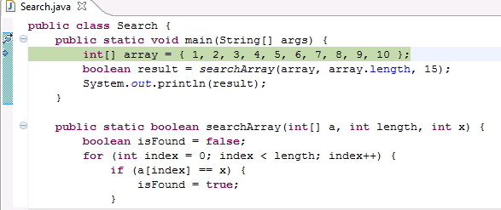
Step Over
Using Step Over, the debugger will go through the code one line at a time

Slide 28
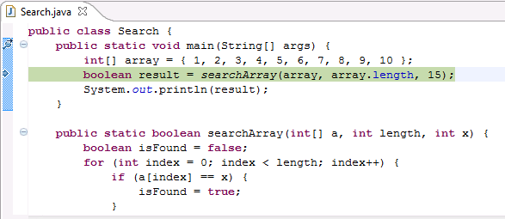
Step Over
Using Step Over, the debugger will go through the code one line at a time

Slide 29
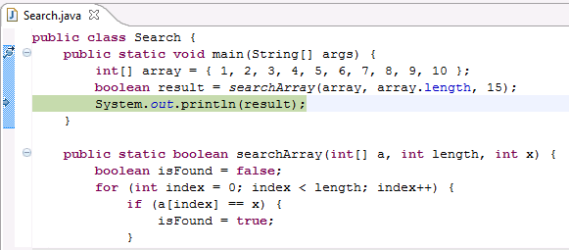
Step Over
Using Step Over, the debugger will go through the code one line at a time

Slide 30
Step Into
If there is a method or constructor in the current line, Step Into will move into the method, otherwise it will handle the same as Step Over

Slide 31
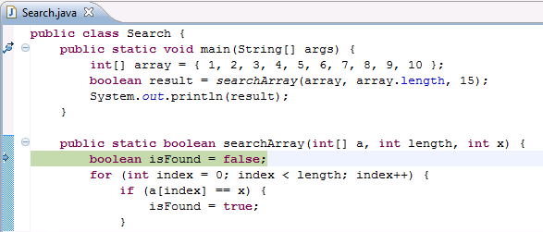
Step Into
If there is a method or constructor in the current line, Step Into will move in and suspend, otherwise it will handle same as Step Over

Slide 32
Step Return
If we are in the middle of a method execution, Step Return will execute until the current method returns and pause immediately

Slide 33
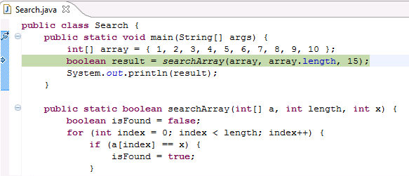
Step Return
If we are in the middle of a method execution, Step Return will execute until the current method returns and pause immediately

Slide 34
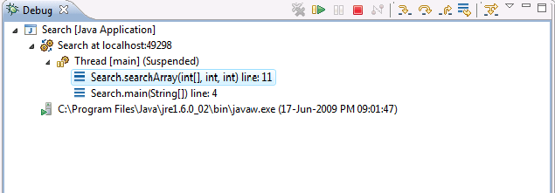
Stepping Through Code
The program stack frame can help us understand and find out where we are in the current program execution. As calls to methods are made, they are added on top of the ‘stack’. As methods are exited, they are removed from the ‘stack’
From the above example, we can see that we are currently executing the searchArray method, and that it was called by the main method

Slide 35
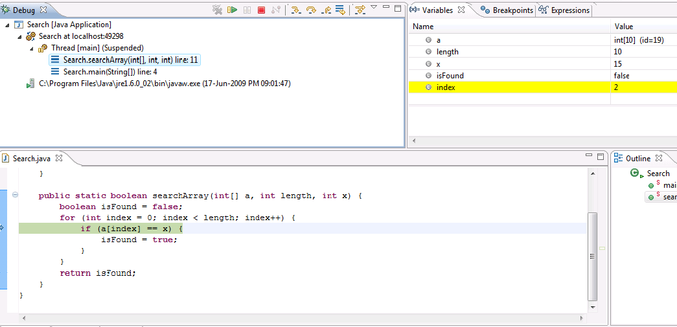
Stepping Through Code
We can select different stack frames here to inspect
As we step through the code, the variables window automatically updates the values of each variable.

Slide 36
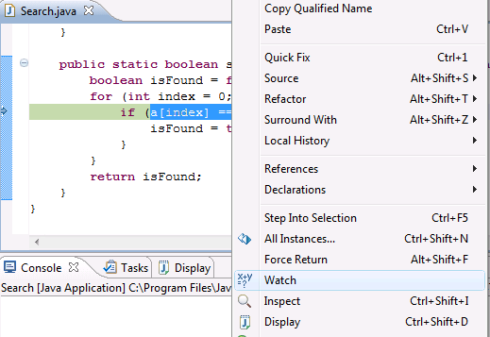
Expressions
The variables window automatically keeps track of variables in the current scope of execution
Eclipse can also keep track of expressions, for example we can add a[index], or a[index]==x to the expressions window to examine its value at any time during execution
To add an expression to the expression window, highlight it in the editor window, right click, and select watch

Slide 37
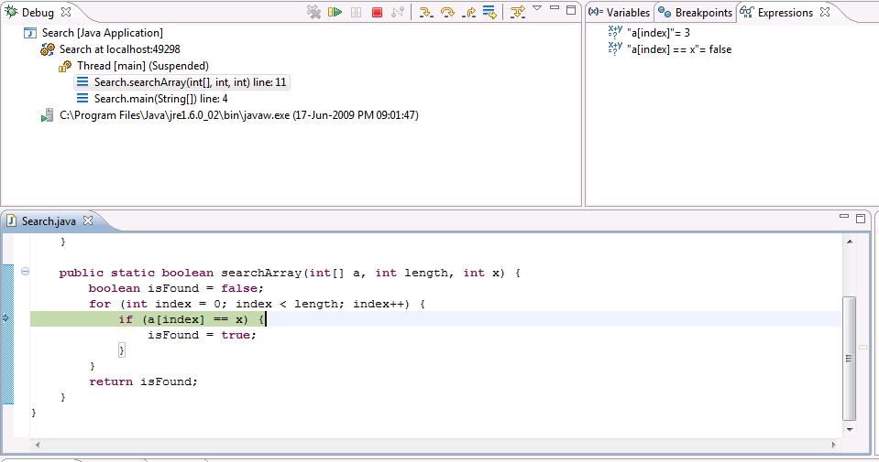
Expressions
Expressions may also be added manually, by right clicking on the expressions window and selecting “Add Watch Expression…”

Slide 38
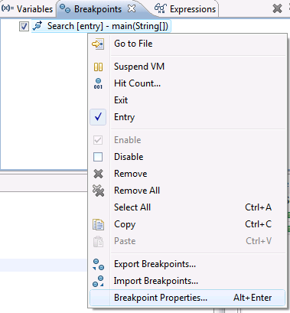
Conditional Breakpoints
Conditional breakpoints may be used to give the user more flexibility when debugging
To set conditions on
a breakpoint, select
the “Breakpoints” tab,
right click on a
breakpoint, and select
“Breakpoint Properties…”

Slide 39
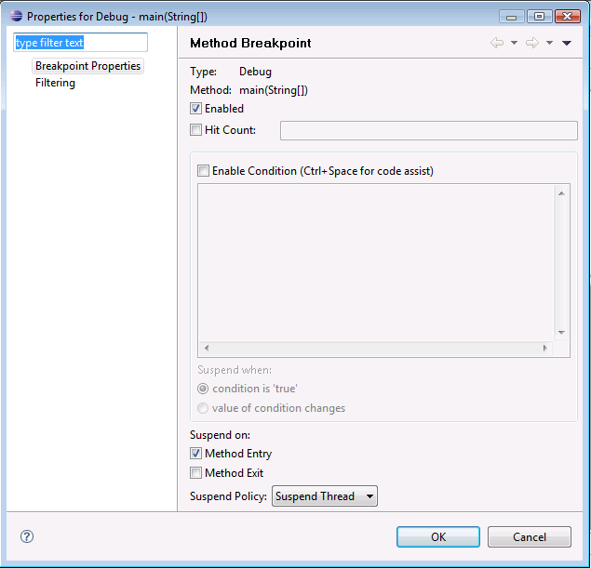
Conditional Breakpoints
Hit count: This option will only suspend the program after the breakpoint has been hit a specified number of times, useful when large loops are involved
Condition: This option will only suspend the program if the specified condition is true, or if the value of the condition changes.

Slide 40
Self-test Assignment: Buggy Sort
Now time to get our hands dirty.
Create a new Java project.
Add a new class called “BuggySort”
Copy the contents of “BuggySort.java” that comes with this tutorial into the “BuggySort” class.
It is supposed to print an array, sort it then print the sorted array.
Now run the program.

Slide 41

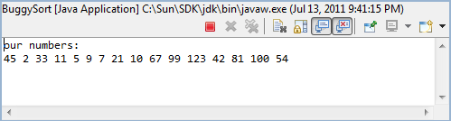
Expected output and Actual output
Expected output that we’d like to see
Actual output. The program actually hangs after printing the initial array.
Now press the red rectangular button to stop execution

Slide 42
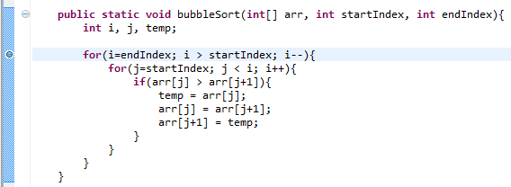
Start Debugging
Since the initial array is printed with no problem. We suspect that it’s the sorting function that enters an infinite loop, causing the hang.
Set a breakpoint at the start of the outer loop, and start debugging by selecting Run -> Debug As -> Java application

Slide 43
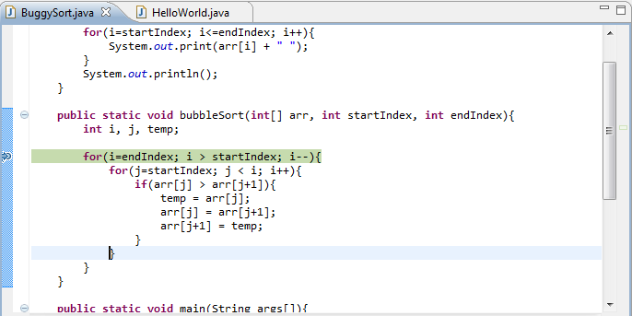
Step through the inner loop once
Now the program pauses at the starting point of the outer loop. We want to check the loop indices as the loops step through iterations.
So, step through the inner loop once and pause at the start of the inner loop.

Slide 44
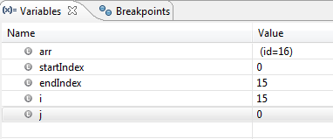
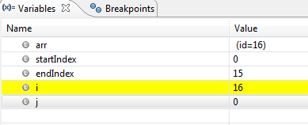
Check loop indices
Current loop indices i and j have values of 15 and 0 respectively, which are correct.
As we step over the wrapping up of the loop, we notice the value of i has changed from 15 to 16, as highlighted by the IDE with the yellow color. This is wrong, we were expecting j to increment.

Slide 45
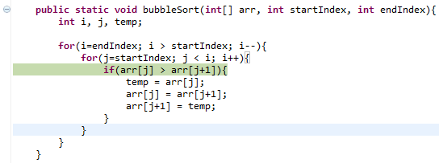
Debug the error
As we examine the code more closely, we find that what should have been “j++” was wrongly typed as “i++”.
Correct it, remove the breakpoint and run again, we should see the program behave correctly.

Slide 46


Slide 47
Graphic User Interface (GUI)–
Google Window Builder
In this section, we will show you how to install GWB, and give a simple tutorial on how to use it to build Java GUI with SWT.
To build GUIs inside Eclipse, we are going to use Google Window Builder (GWB): a Drag and Drop Java GUI creator for the Eclipse IDE.
GWB is a component for the Eclipse IDE and is available as a plug in.
GWB supports both Standard Widget Toolset(SWT) and Google Web Toolset(GWT) – Two Java GUI libraries.
SWT documentation http://www.eclipse.org/swt/docs.php

Slide 48
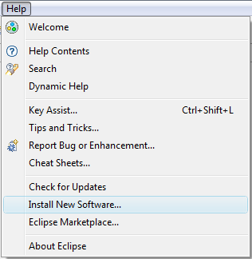
Installing the Google Window Builder
To install GWB with Eclipse 3.7 Indigo, start up Eclipse and click on Help -> Install New Software…

Slide 49
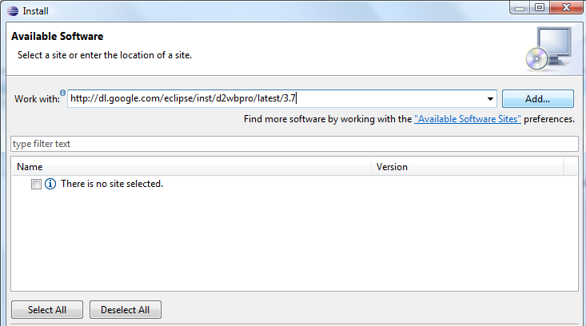
Installing the Google Window Builder
Enter http://dl.google.com/eclipse/inst/d2wbpro/latest/3.7
2. Click Add…

Slide 50
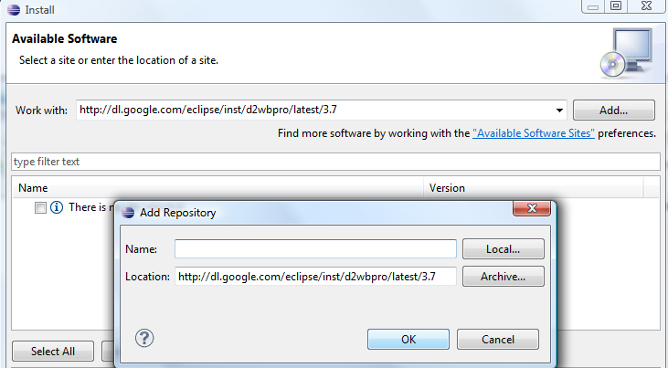
Installing the Google Window Builder
Leave the name field blank and click OK.

Slide 51
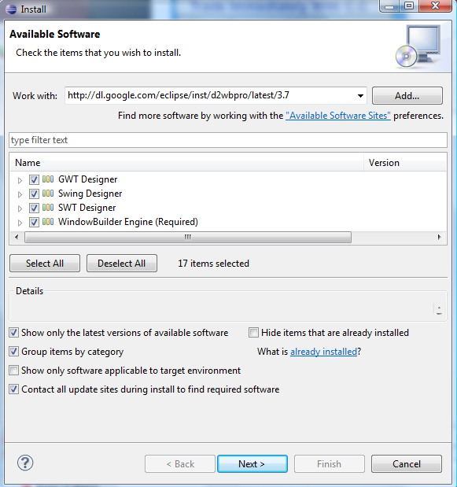
Installing the Google Window Builder
Select all packages, then click Next. Then click Next all the way until the installation finishes. If you are prompted with a User License Agreement, remember to accept.

Slide 52
How GUI works?
Hierarchical Structure of Containers And Components
Toplevel Container
Appearance
Sub Container
…….
Sub Container
Component
……
Component
……
Component
Event Handlers
Behavior
button_click,
mouse_click,
window_resize,
Etc…

Slide 53
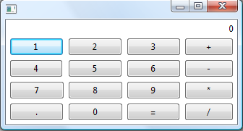
Appearance
Containers hold components together logically and graphically
This entire window is the toplevel container
Label component
Components are functional parts for input and output
Button Components

Slide 54



Behavior
We do these.
GUI
Handler 1
Button
User
Dispatching Mechanism
Handler 2
Button
Handler 3
Button
This is handled by the SWT library.
Don’t worry about it.
Event Sources
Event
Handlers
Event Driven Programming
TOPIC: GUI programming from ground up | SPEAKER: Frank | SLIDE

Slide 55
Publish/Subscribe style of programming
Publishers do not send events directly to subscribers. Instead, they sent to the dispatcher
Subscribers do not actively poll the publishers for events. Instead, they indicate to the dispatcher the events they are interested in
The dispatcher acts as an agent, receiving events from publishers and dispatching them to interested subscribers.

Slide 56
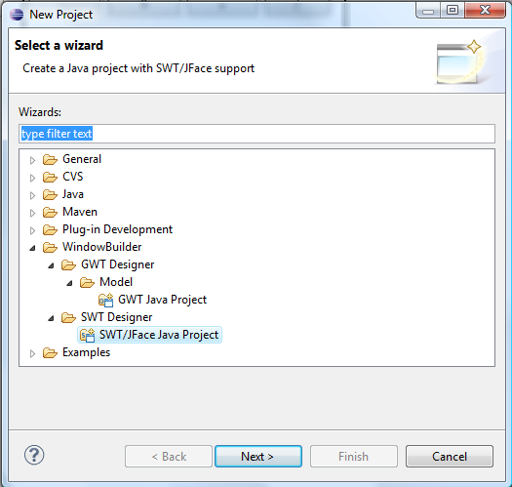
Time to get our hands dirty
Select File -> New -> Project
Select “SWT/Jface Java Project” then click Next

Slide 57
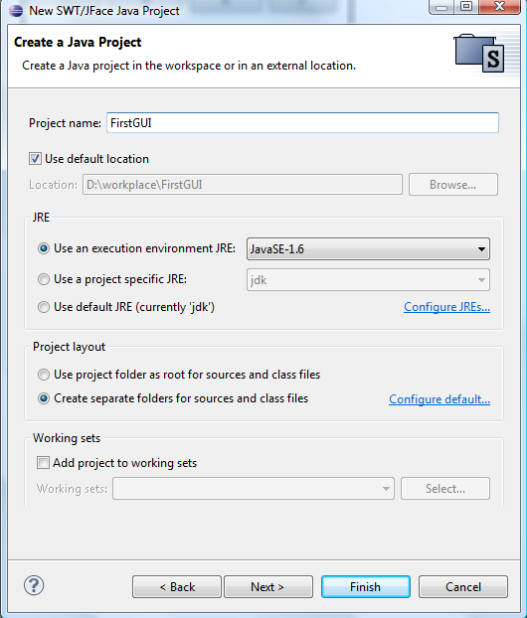
Create a new project.
Enter “FirstGUI” as project name and click Finish

Slide 58
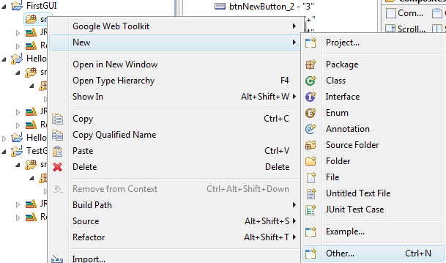
Add a new container class
Right click on the “src” folder in Package Explorer, select New -> Other

Slide 59
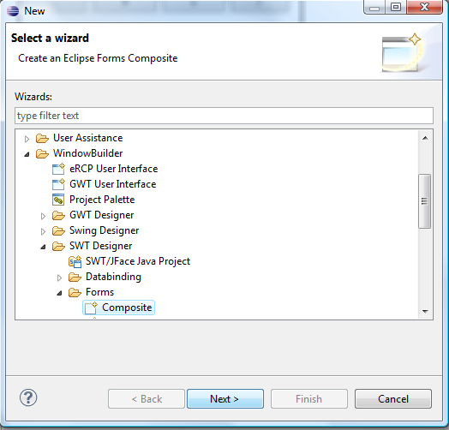
Add a new container class
Select “Composite” and press Next. A composite is basically a generic container

Slide 60
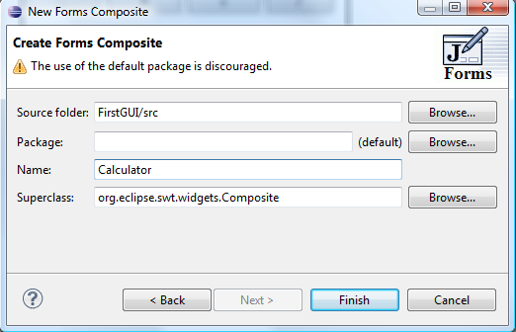
Add a new container class
Enter a name, say “Calculator” then click Finish

Slide 61
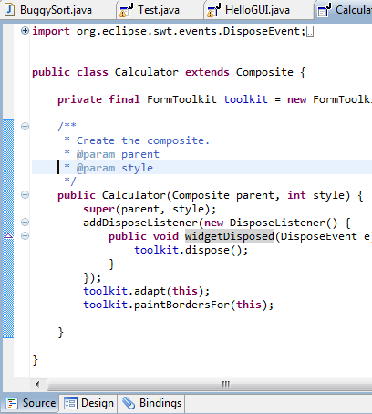
The Editor, Source View
Not much different from a normal Java class, eh? Well, this is the source view. We can program our entire GUI by coding here, though it’s not really efficient to do so.
We can click “Design” to switch to design view, where we can draw our GUI in a WYSIWYG manner.
Alternatively we can alternate between these two modes by pressing F12

Slide 62
Main function
We don’t have a main function yet. So before going into design view, add the following main function:
public static void main(String[] args){
Display display = new Display();
Shell shell = new Shell(display);
Calculator calc = new Calculator(shell, SWT.NONE);
calc.pack();
shell.pack();
shell.open();
while(!shell.isDisposed()){
if(!display.readAndDispatch()) display.sleep();
}
} #End of main()
“Display” is the backend, handling interface to the operating systems and also serving as the dispatcher.
“Shell” is a window.
The “pack” function simply asks the components to resize themselves to take minimum space that fit.

Slide 63
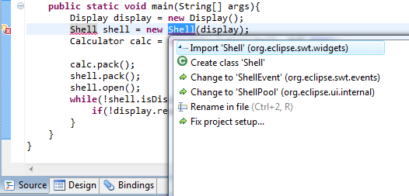
Import the necessary libraries
You may have some errors with “shell” or “display” which have not been imported yet.
However, notice the light bulb besides the red cross, this is something Eclipse IDE can help us handle.
Choose “Import” from the list of suggestions by Eclipse

Slide 64
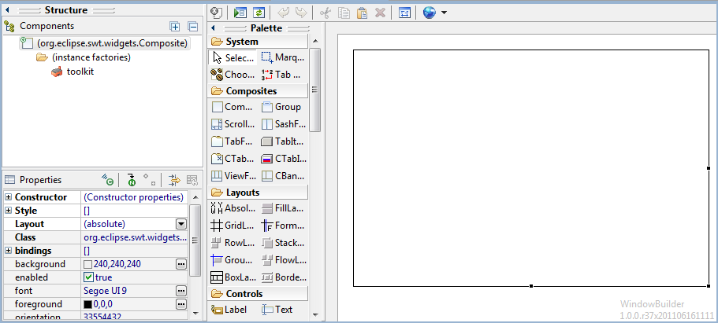
The Editor, Design View
Properties of the selected object can be viewed and changed here, in the Property View.
The Palette. We can drag and drop stuff from here to the canvas.
This is the drawing canvas. Click on the blank area to select our blank container. Notice the black border around the container. That indicates we have successfully selected it.

Slide 65

Layout
With our toplevel container selected, open the drop down menu next to the layout property, and select “FormLayout”.
This property guides the container in positioning the components it contains.
FormLayout provides help in aligning the edges of the components contained in the container.

Slide 66

Label
Drag and draw a label here
Click Label to select it, then move the cursor to the canvas.

Slide 67

Properties
Select the label just drawn by clicking on it. In the properties view, we can view or change the variable name associated with the selected object. In this case, the label’s variable name is lblNewLabel
Change the alignment to “RIGHT” by selecting it in the drop down menu
Change the text to 0 by clicking on the field next to the property “text” and typing

Slide 68

What you should see
Now press F12 to switch to source view.

Slide 69


In Source View
Notice that when we draw on the canvas, the codes reflect the changes. This chunk of codes correspond to the addition of that label.
Notice that this label is declared solely in the constructor. This makes it hard for us to refer to it later on. The logical thing to do is to convert this label into a member of the Calculator class. We can either do it in the source view manually, or in the design view, click “Convert local to field” in the properties view of the label.

Slide 70

Sub container
Now we draw a sub container to hold all the buttons.
Select “Composite”, then draw it on the canvas as shown.
Then select the drawn composite, and change its layout to GridLayout. GridLayout organizes its components in grid, which is a perfect fit for our array of buttons.

Slide 71

Button
Select Button, then place it at column 0, row 1 of the grid.

Slide 72

Buttons, Buttons…
Then add 15 more buttons to fill the grid like this

Slide 73

Change Button Text
Now change the buttons’ text properties in the same way.
You should see this
Notice that the buttons are shrunk to fit the text size. We’d actually like them to be larger. Here’s how.
Double click on this scale “1”.

Slide 74

Extra room for expansion
Now we have all the room in the world for expansion.
Enlarge the button 1 as you see fit, then double click the scale “1” to contract this column to fit the button.

Slide 75

Now resize all the other buttons bigger

Slide 76

Appearance completed…
Now we are going to add event handlers so that pressing these 9 digit buttons will increment the number shown in the label accordingly.
Of course, this is not so calculator-like. However, in doing so, you will learn everything you need to know for the calculator GUI.
The task to complete the calculator is then left as your exercise. ☺

Slide 77

Add button click event handler
(2) In the properties view, click the green “Show Events” button.
(3) Double click “widgetSelection”
(1) Select button 1 first.

Slide 78

Event Handler Code
You will be automatically brought to source view. Notice the skeleton provided by the IDE. It is an instance of an anonymous class that extends “SelectionAdapter”.
Add the following piece of codes into the method “widgetSelected”:
Button b = (Button)e.getSource();
int num = Integer.parseInt(lblNewLabel.getText());
num += Integer.parseInt(b.getText());
lblNewLabel.setText(num+"");
It’s pretty self-explanatory. “e” is the event object, from which we can find its publisher by the method “getSource”. We get the number on the button and increment it to the number in the label.

Slide 79

Run it!
Run our program, even though it only responds to button ‘1’. Try clicking on it and see that
the number in the label increases.

Slide 80


Optimization
Then we realize that writing a handler for each different button click can be quickly tiring.
We want one handler to deal with all those 9 buttons
Now
Previous
Of course, we must let the Calculator class implement the SelectionListener interface

Slide 81

Optimization
And the obligatory interface methods to implement

Slide 82

Optimization
Then simply let the Calculator class to subscribe to all the other 8 buttons like this.

Slide 83
Run It And Have Fun!

Slide 84

Importing Projects into Eclipse Workspace
Select File -> Import
Then select “Existing Projects into Workspace”, before clicking “Next”

Slide 85

Importing Projects into Eclipse Workspace
Browse to the root directory of the project,
Check the “Copy projects into workspace” option then click “Finish”

